Slide 1
Object Oriented Programming Part 4: Polymorphism
By: Ryan Alterman
Revised: 10-25-17

Slide 2
What is Polymorphism?
Definition:
To have many forms.
This occurs when there is a hierarchy of classes in a project
They are related by inheritance
Means that a member function will be executed based on which object calls it
Used to:
Create child classes that have the same function but different implementation
Static Resolution/Linkage
When the compiler will prematurely link a function to the base class instead of other functions
Also called early binding

Slide 3
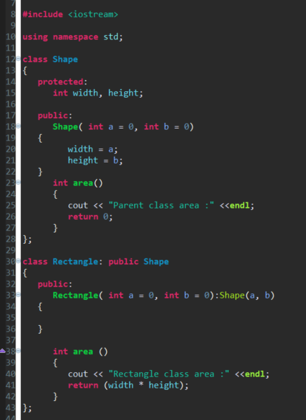
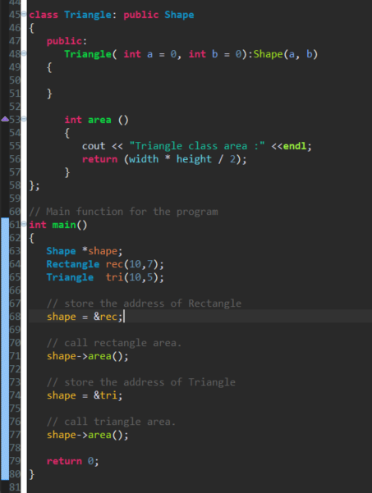
Example of Polymorphism with Static Linkage

Slide 4
Virtual Function
Called in a base class using the virtual keyword
Combined with derived classes to break static linkage
Dynamic Linkage / Late Binding
Allows the function to be selected at any time
The selection is to be based on the type of object that is performing the call

Slide 5
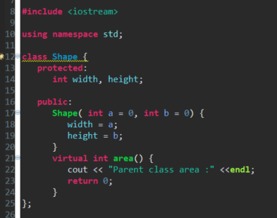
Example of Polymorphism with Dynamic Linkage

Slide 6
Pure Virtual Functions
We can create virtual functions with no body( no definition)
This allows us to create functions that can be derived, but have no effect in the Base class
This is called pure virtual functions
You assign the function a value of zero
= 0
Tells the compiler there is no body

Slide 7
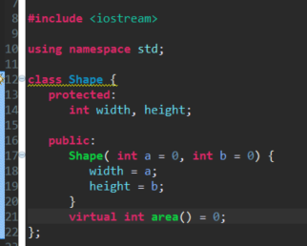
Creating Pure Virtual Functions

Slide 8
Challenge
Why would we care about racking and using Polymorphism? When would we use it? Create a Polymorphic set of classes that use pure virtual functions to create dynamic linkage.

Slide 9
Next: Object Oriented Programming Part 5

